Slide 1
9.0_Electonic Component
PDS
SDN
NFV
Computer Vision
https://github.com/siagianp
https://www.youtube.com/@AmelOline/videos
https://github.com/amelcharolinesgn2/IoT_simulator-mqtt-NodeRed
https://github.com/amelcharolinesgn2/Cloud-Infrastructures
https://github.com/amelcharolinesgn2/ClouD-Infrastructure-SISKA-2025

Slide 2
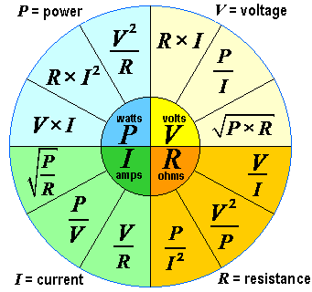
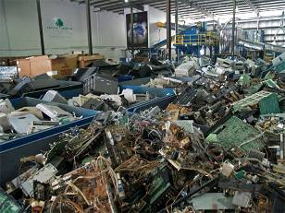
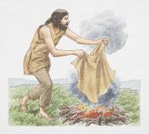
Signals, Circuits, and Computers

Slide 3
Electronic Circuits and Components
An “Electronic Circuit “ is a combination of electronic components and conductive wires interconnected in a way as to achieve an outcome: - Achieve a current /voltage of a certain value (signal)
- Amplify a signal
- Transfer data
CIRCUIT
Input
Output
The purpose of an electronic component is to allow the designer to control the flow of current as to achieve a specified result/output.
(Resistors, Capacitors, Inductors, Diodes, Transistors )

Slide 4
Electronic Components
Active Components (have directionality)
Semiconductor devices-transistors
Passive Components (Have no directionality)
Resistors, capacitors, inductors, diodes
(diodes and polarized capacitors must be
installed in a specified way)

Slide 5
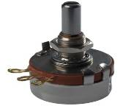
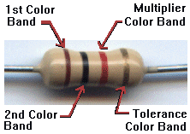
Electronic Components (cont.)
A. Resistors:
Resistors are passive elements that oppose/restrict the flow of current.
A voltage is developed across its terminal, proportional to the current through the resistor.
V = IR
Units: Ohms (Ω)

Slide 6
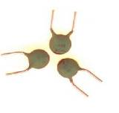
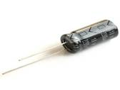

Electronic Components (cont.)
B. Capacitors
behave like a tiny rechargeable battery. (store energy and release it later. )
are made of two parallel conductors separated by a dielectric.
are used for filtering, tuning, separating signals , etc.
The ability of a capacitor to store charge is called “Capacitance”
C = Q/V (amount of charge stored/applied voltage)
The unit of capacitance is the Farad. Commonly used capacitances are much smaller than 1 Farad, micro-Farads (10⁻⁶ Farad, μF),
nano-Farads (10⁻⁹ Farad, nF), pico-Farads (10⁻¹² Farad, pF).

Slide 7


Electronic Components (cont.)
Transistors
Transistors are commonly used for signal amplification, switching, voltage regulation, etc.
Symbol for the NPN Transistor
collector
base
emitter
Symbol for the PNP Transistor

Slide 8
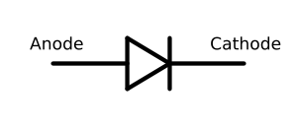

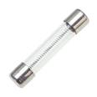
Electronic Components (cont.)
Diodes are semiconductor devices that allow
current in only one direction
Fuses are devices that protect the circuit from overload.
Are made of a wire that melts when the current through it exceeds a specified value

Slide 9
Q5. Which of the following components used in a circuit stores energy?
Resistors
Inductors
Capacitors
Diodes
Transistors

Slide 10
Q6. Which of the following components used in a circuit allows the current to flow one way
Resistors
Inductors
Capacitors
Diodes
Fuses

Slide 11
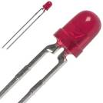
Electronic Components (cont.)
LEDs- Light Emitting Diodes:
A special kind of diode: They allow current to flow in one direction.
The LED will light up when the proper amount of current passes through.
1-3
4
5

Slide 12
Electronic Components (cont.)
Infrared Detectors
The appearance of these infrared photo detectors and the internal structure is similar to that of an LED.
The infrared photo detector has a focal direction, and the detection angle is about 15°. (8x15=120˚)
This small detection angle allows the controller to tell the direction where the infrared light comes from.
3
0
7

Slide 13
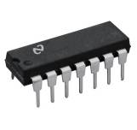
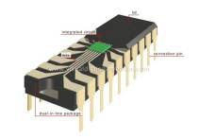
Integrated Circuits
A small scale electronic CKT on a substrate
of semiconductor material
Orientation
Selector
Amplifier
Counter
Tuning CKT

Slide 14
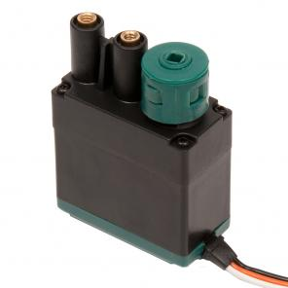
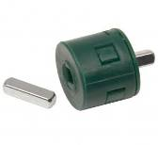
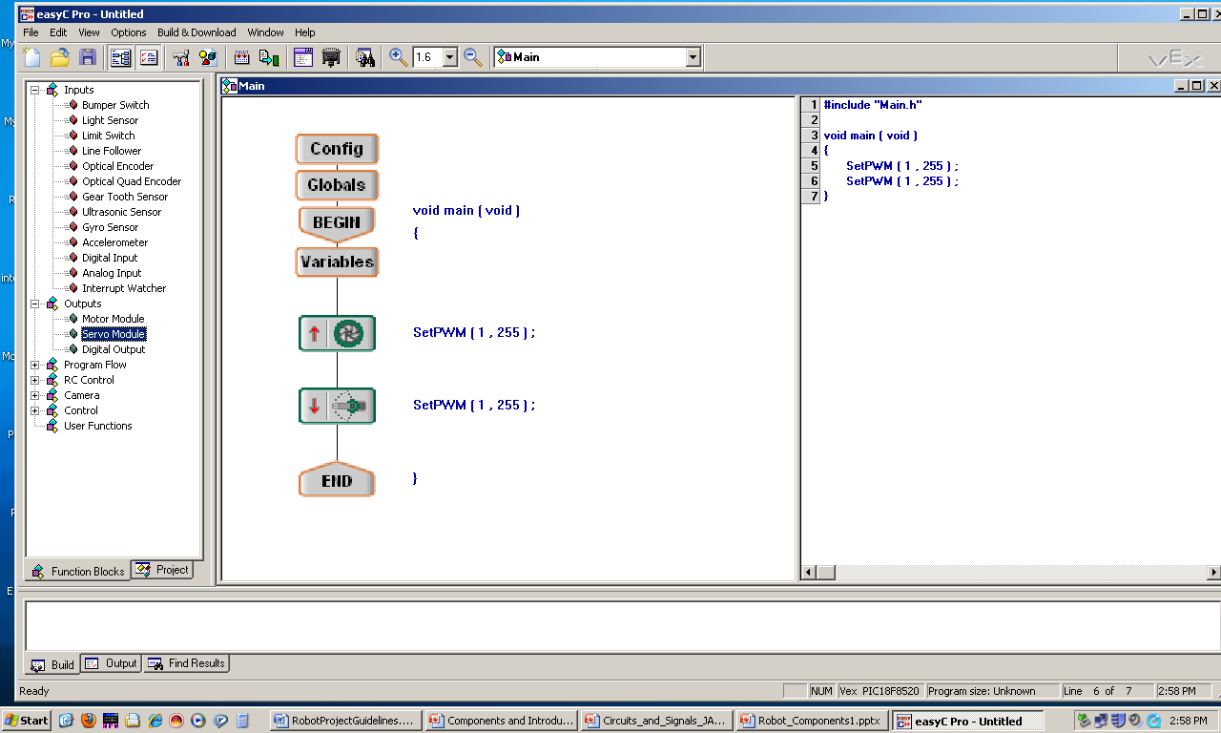
Robotic Component Functional Summary*
B. Motors
Motors are devices that can transform electrical energy into mechanical energy.
Control the movement/speed of the robot.
Direction: CW or CCW.
SWR Command:
SetPWM[Port #, Direction & Speed# ]
Range: Direction & Speed:
000 CCW-High
127 STOP
255 CW - High
*E10 Manual-Vex Robotics Design System

Slide 15
Robotic Component Functional Summary (cont.)
C. Servos
Servo motors are a type of motor that can be directed to turn to a specific direction, rather than just spin forward or backward.
SWR Command: SetPWM [ Port#, Direction Value]

Slide 16
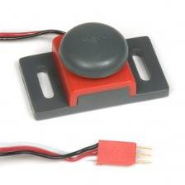

Robotic Component Functional Summary(cont.)
C. The Bumper
- The bumper switch is a digital sensor.
- It tells the robot whether the bumper on the front of the sensor is being pushed in or not.
SWR Command: bumperL = GetDigitalInput[Port#]
VEX
Digital
IO Port
5v
Input
0v
Input =1 (or 5V) when the bumper is not pushed.
Input =0 (or 0V) when the bumper is pushed.

Slide 17
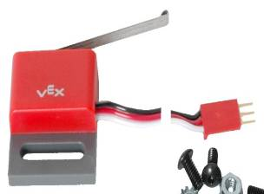

Robotic Component Functional Summary (cont.)
The limit switch (similar to Bumper SW)
The limit switch is a digital sensor.
It can tell the robot whether the sensor’s metal arm is being pushed down or not.
SWR Command: GetDigitalInput[Port#]
When the limit switch is not being pushed in, the sensor maintains a digital HIGH signal on its sensor port. (1 or 5v.)
When an external force (like a collision or being pressed up against a wall) pushes the switch in, it changes its signal to a digital LOW until the limit switch is released. (0 or 0v.)

Slide 18
Q7. What is the state of the bumper input in Fig 1.?
VEX
Digital
IO Port
5v
Input
0v
Fig. 1.
a. Input =1 (or 5V).
b. Input =0 (or 0V)

Slide 19
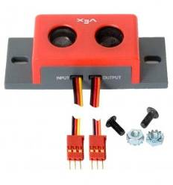
Robotic Component Functional Summary (cont.)
Ultrasonic range finder
An ultrasonic range finder sensor enables a robot to detect obstacles in its path by utilizing the propagation of high-frequency sound waves.
The sensor emits a sound wave, which bounces off a reflective surface and returns to the sensor. Then, using the amount of time it takes for the wave to return to the sensor, the distance to the object can be computed.

Slide 20
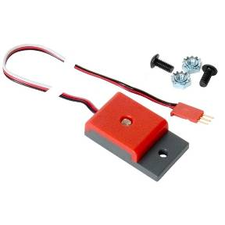
Robotic Component Functional Summary (cont.)
The light sensor
The light sensor uses a photocell that allows your robot to detect and react to light.
Analog input of light levels:
Find dark or bright areas.
It uses a photoconductive photocells which are photo resistors, meaning that their resistance value changes based on the amount of incident light.

Slide 21
PDS
SDN
NFV
Computer Vision
Thank You !!
https://github.com/siagianp
https://www.youtube.com/@AmelOline/videos
https://github.com/amelcharolinesgn2/IoT_simulator-mqtt-NodeRed
https://github.com/amelcharolinesgn2/Cloud-Infrastructures
https://github.com/amelcharolinesgn2/ClouD-Infrastructure-SISKA-2025

